Slide 1
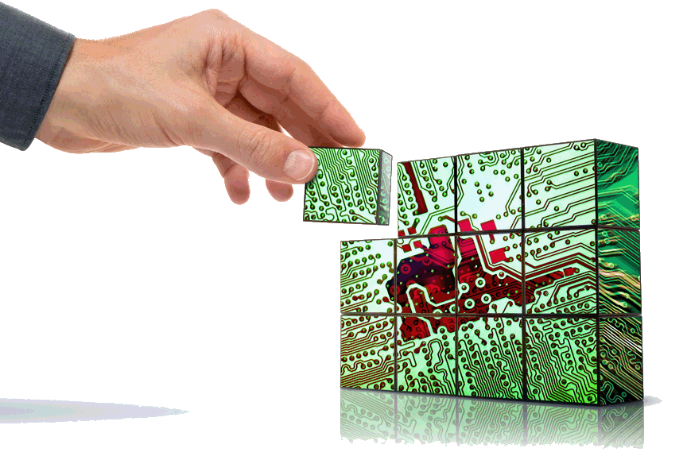
CSE423: Embedded Systems
Summer, 2019
Introduction to Embedded Systems

Slide 2
Today’s Lecture
What is the embedded system?
Challenges in embedded computing system design.
CSE423@DIU, Summer 2019

Slide 3
What Are Embedded Systems?
Definition: An Embedded System is any device that includes a programmable computer but is not itself a general-purpose computer.
Take advantage of application characteristics to optimize the design:
  Performance
  Cost/size
  Real time requirements
  Power consumption
  Reliability
  etc.
CSE423@DIU, Summer 2019

Slide 4
Early History
Late 1940’s: MIT Whirlwind computer was designed for real-time operations.
  Originally designed to control an aircraft simulator.
First microprocessor was Intel 4004 in early 1970’s.
HP-35 calculator used several chips to implement a microprocessor in 1972.
Automobiles used microprocessor-based engine controllers starting in 1970’s.
  Control fuel/air mixture, engine timing, etc.
  Provides lower emissions, better fuel efficiency.
CSE423@DIU, Summer 2019

Slide 5





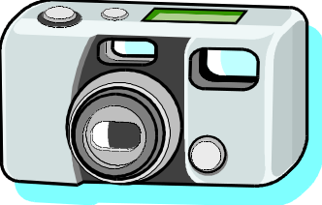
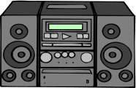


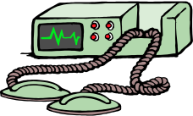


A Short List of Embedded Systems
Anti-lock brakes
Auto-focus cameras
Automatic teller machines
Automatic toll systems
Automatic transmission
Avionic systems
Battery chargers
Camcorders
Cell phones
Cell-phone base stations
Cordless phones
Cruise control
Curbside check-in systems
Digital cameras
Disk drives
Electronic card readers
Electronic instruments
Electronic toys/games
Factory control
Fax machines
Fingerprint identifiers
Home security systems
Life-support systems
Medical testing systems
Modems
MPEG decoders
Network cards
Network switches/routers
On-board navigation
Pagers
Photocopiers
Point-of-sale systems
Portable video games
Printers
Satellite phones
Scanners
Smart ovens/dishwashers
Speech recognizers
Stereo systems
Teleconferencing systems
Televisions
Temperature controllers
Theft tracking systems
TV set-top boxes
VCR’s, DVD players
Video game consoles
Video phones
Washers and dryers
CSE423@DIU, Summer 2019

Slide 6
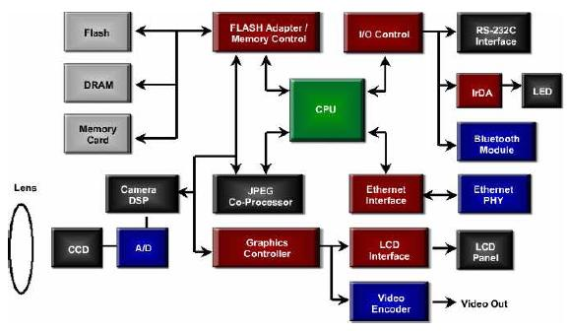
An Application Example: Digital Camera
Digital Camera Block Diagram
CSE423@DIU, Summer 2019

Slide 7
Components of Embedded Systems
Memory
Controllers
Interface
Software
(Application Programs)
Processor
Coprocessors
ASIC
Converters
Analog
Digital
Analog
CSE423@DIU, Summer 2019

Slide 8
Components of Embedded Systems
Analog Components
  Sensors, Actuators, Controllers, …
Digital Components
  Processor, Coprocessors
  Memories
  Controllers, Buses
  Application Specific Integrated Circuits (ASIC)
Converters – A2D, D2A, …
Software
  Application Programs
  Exception Handlers
CSE423@DIU, Summer 2019

Slide 9
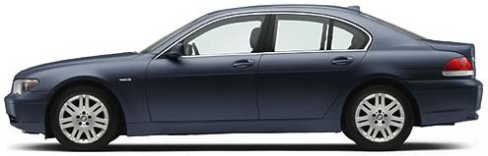
Automotive Embedded Systems
Today’s high-end automobile may have 100 microprocessors:
  4-bit microcontroller checks seat belt;
  microcontrollers run dashboard devices;
  16/32-bit microprocessor controls engine.
Customer’s requirements
  Reduced cost
  Increased functionality
  Improved performance
  Increased overall dependability
CSE423@DIU, Summer 2019

Slide 10
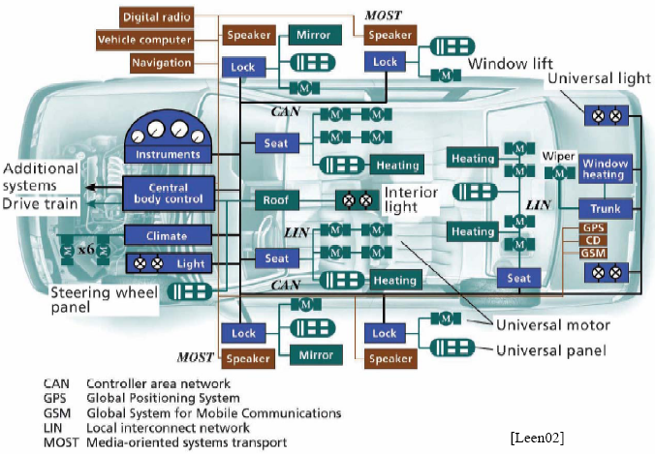
An Engineering View
CSE423@DIU, Summer 2019

Slide 11
BMW 850i Brake and Stability Control System
Anti-lock brake system (ABS): pumps brakes to reduce skidding.
Automatic stability control (ASC+T): controls engine to improve stability.
ABS and ASC+T communicate.
  ABS was introduced first---needed to interface to existing ABS module.
CSE423@DIU, Summer 2019

Slide 12
BMW 850i, cont’d.
sensor
sensor
brake
brake
ABS
hydraulic
pump
brake
brake
sensor
sensor
CSE423@DIU, Summer 2019

Slide 13
Why Use Microprocessors?
Alternatives: field-programmable gate arrays (FPGAs), custom logic, application specific integrated circuit (ASIC), etc.
Microprocessors are often very efficient: can use same logic to perform many different functions.
Microprocessors simplify the design of families of products.
CSE423@DIU, Summer 2019

Slide 14
Why Use Microprocessors?
Two factors that work together to make microprocessor-based designs fast
  First, microprocessors execute programs very efficiently. While there is overhead that must be paid for interpreting instructions, it can often be hidden by clever utilization of parallelism within the CPU
  Second, microprocessor manufacturers spend a great deal of money to make their CPUs run very fast.
CSE423@DIU, Summer 2019

Slide 15
Why Use Microprocessors?
Performance
  Microprocessors use much more logic to implement a function than does custom logic.
  But microprocessors are often at least as fast:
    heavily pipelined;
    large design teams;
    aggressive VLSI technology.
Power consumption
  Custom logic is a clear winner for low power devices.
  Modern microprocessors offer features to help control power consumption.
  Software design techniques can help reduce power consumption.
Heterogeneous systems: some custom logic for well-defined functions, CPUs+ software for everything else.
CSE423@DIU, Summer 2019

Slide 16
Microprocessor Varieties
Microcontroller: includes I/O devices, on-board memory.
Digital signal processor (DSP): microprocessor optimized for digital signal processing.
Typical embedded word sizes: 8-bit, 16-bit, 32-bit.
CSE423@DIU, Summer 2019

Slide 17
Microprocessor Varieties
4-bit, 8-bit, 16-bit, 32-bit :
  8-bit processor : more than 3 billion new chips per year
  32-bit microprocessors : PowerPC, 68k, MIPS, and ARM chips.
  ARM-based chips alone do about triple the volume that Intel and AMD peddle to PC makers.
Most (98% or so) 32-bit processors are used in embedded systems, not PCs.
RISC-type processor owns most of the overall embedded market [MPF: 2002].
CSE423@DIU, Summer 2019

Slide 18
Platforms
Embedded computing platform: hardware architecture + associated software.
Many platforms are multiprocessors.
Examples:
  Single-chip multiprocessors for cell phone baseband.
  Automotive network + processors.
CSE423@DIU, Summer 2019

Slide 19
The physics of software
Computing is a physical act.
  Software doesn’t do anything without hardware.
Executing software consumes energy, requires time.
To understand the dynamics of software (time, energy), we need to characterize the platform on which the software runs.
CSE423@DIU, Summer 2019

Slide 20
Challenges in Embedded Computing System Design
How much hardware do we need?
How do we meet deadlines?
How do we minimize power consumption?
How do we design for upgradability?
Does it really work?
CSE423@DIU, Summer 2019

Slide 21
What does “Performance” mean?
In general-purpose computing, performance often means average-case, may not be well-defined.
In real-time systems, performance means meeting deadlines.
  Missing the deadline by even a little is bad.
  Finishing ahead of the deadline may not help.
CSE423@DIU, Summer 2019

Slide 22
Characterizing performance
We need to analyze the system at several levels of abstraction to understand performance:
  CPU: microprocessor architecture.
  Platform: bus, I/O devices.
  Program: implementation, structure.
  Task: multitasking, interaction between tasks.
  Multiprocessor: interaction between processors.
CSE423@DIU, Summer 2019

Slide 23
Characteristics of Embedded Systems
Very high performance, sophisticated functionality
  Vision + compression + speech + networking all on the same platform.
Multiple task, heterogeneous.
Real-time.
Often low power.
Low manufacturing cost..
Highly reliable.
  I reboot my piano every 4 months, my PC every day.
Designed to tight deadlines by small teams.
CSE423@DIU, Summer 2019

Slide 24
Functional Complexity
Often have to run sophisticated algorithms or multiple algorithms.
  Cell phone, laser printer.
Often provide sophisticated user interfaces.
CSE423@DIU, Summer 2019

Slide 25
Real-Time Operation
Must finish operations by deadlines.
  Hard real time: missing deadline causes failure.
  Soft real time: missing deadline results in degraded performance.
Many systems are multi-rate: must handle operations at widely varying rates.
CSE423@DIU, Summer 2019

Slide 26
Design methodologies
A procedure for designing a system.
Understanding your methodology helps you ensure you didn’t skip anything.
Compilers, software engineering tools, computer-aided design (CAD) tools, etc., can be used to:
  help automate methodology steps;
  keep track of the methodology itself.
CSE423@DIU, Summer 2019

Slide 27
Design goals
Performance.
  Overall speed, deadlines.
Functionality and user interface.
Manufacturing cost.
Power consumption.
Other requirements (physical size, etc.)
CSE423@DIU, Summer 2019

Slide 28
Levels of abstraction
requirements
specification
architecture
component
design
system
integration
CSE423@DIU, Summer 2019

Slide 29
Top-down vs. bottom-up
Top-down design:
  start from most abstract description;
  work to most detailed.
Bottom-up design:
  work from small components to big system.
Real design uses both techniques.
CSE423@DIU, Summer 2019

Slide 30
Stepwise refinement
At each level of abstraction, we must:
  analyze the design to determine characteristics of the current state of the design;
  refine the design to add detail.
CSE423@DIU, Summer 2019

Slide 31
Requirements
Plain language description of what the user wants and expects to get.
May be developed in several ways:
  talking directly to customers;
  talking to marketing representatives;
  providing prototypes to users for comment.
CSE423@DIU, Summer 2019

Slide 32
Functional vs. non-functional requirements
Functional requirements:
  output as a function of input.
Non-functional requirements:
  time required to compute output;
  size, weight, etc.;
  power consumption;
  reliability;
  etc.
CSE423@DIU, Summer 2019

Slide 33
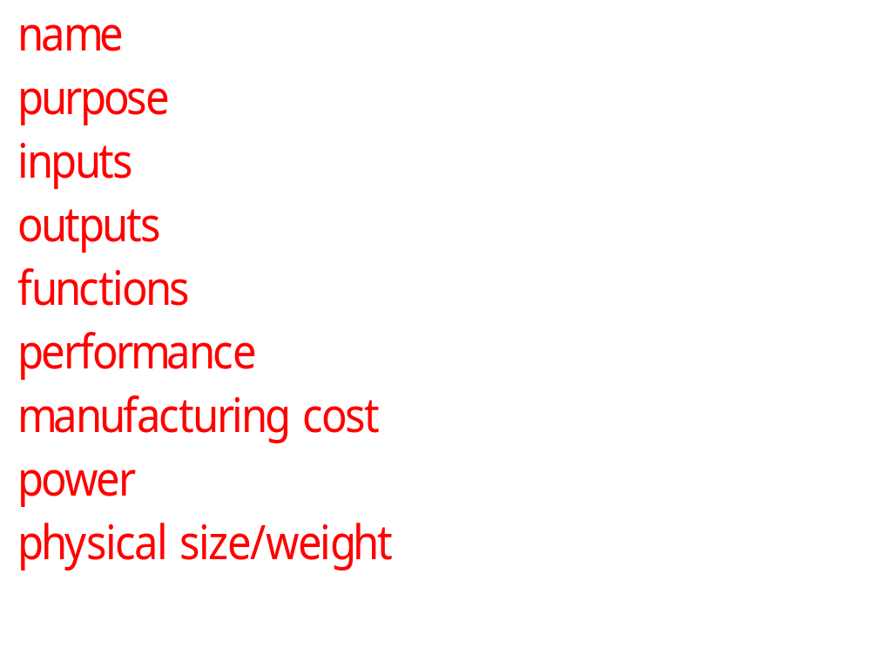
Our requirements form
CSE423@DIU, Summer 2019

Slide 34
Example: GPS moving map requirements
Moving map obtains position from GPS, paints map from local database.
I-78
Scotch Road
lat: 40 13 lon: 32 19
CSE423@DIU, Summer 2019

Slide 35
GPS moving map needs
Functionality: For automotive use. Show major roads and landmarks.
User interface: At least 400 x 600 pixel screen. Three buttons max. Pop-up menu.
Performance: Map should scroll smoothly. No more than 1 sec power-up. Lock onto GPS within 15 seconds.
Cost: $120 street price = approx. $30 cost of goods sold.
CSE423@DIU, Summer 2019

Slide 36
GPS moving map needs, cont’d.
Physical size/weight: Should fit in hand.
Power consumption: Should run for 8 hours on four AA batteries.
CSE423@DIU, Summer 2019

Slide 37
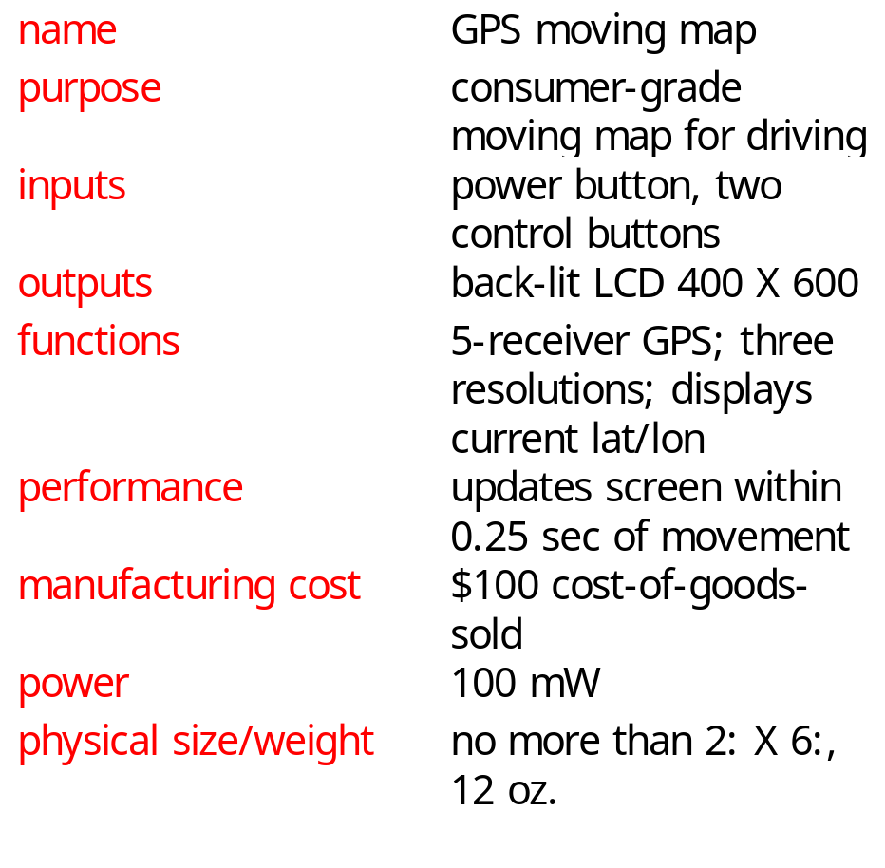
GPS moving map requirements form
CSE423@DIU, Summer 2019

Slide 38
Specification
A more precise description of the system:
  should not imply a particular architecture;
  provides input to the architecture design process.
May include functional and non-functional elements.
May be executable or may be in mathematical form for proofs.
CSE423@DIU, Summer 2019

Slide 39
GPS specification
Should include:
  What is received from GPS;
  map data;
  user interface;
  operations required to satisfy user requests;
  background operations needed to keep the system running.
CSE423@DIU, Summer 2019

Slide 40
Architecture design
What major components go satisfying the specification?
Hardware components:
  CPUs, peripherals, etc.
Software components:
  major programs and their operations.
Must take into account functional and non-functional specifications.
CSE423@DIU, Summer 2019

Slide 41
GPS moving map block diagram
GPS
receiver
search
engine
renderer
display
database
user
interface
CSE423@DIU, Summer 2019

Slide 42
GPS moving map hardware architecture
display
frame
buffer
CPU
GPS
receiver
memory
panel I/O
CSE423@DIU, Summer 2019

Slide 43
GPS moving map software architecture
position
database
search
renderer
pixels
user
interface
timer
CSE423@DIU, Summer 2019

Slide 44
Designing hardware and software components
Must spend time architecting the system before you start coding.
Some components are ready-made, some can be modified from existing designs, others must be designed from scratch.
CSE423@DIU, Summer 2019

Slide 45
System integration
Put together the components.
  Many bugs appear only at this stage.
Have a plan for integrating components to uncover bugs quickly, test as much functionality as early as possible.
CSE423@DIU, Summer 2019

Slide 46
Summary
Embedded computers are all around us.
  Many systems have complex embedded hardware and software.
Embedded systems pose many design challenges: design time, deadlines, power, etc.
Design methodologies help us manage the design process.
CSE423@DIU, Summer 2019

